Slide 1
PHYS 304: Lecture 21 (Intro to) Quantum Mechanics
Sept-Dec 2021 Edition
Jeff Young
brimacombe Rm 278, young@phas.ubc.ca

Slide 2

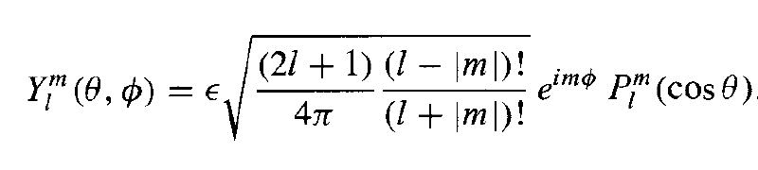
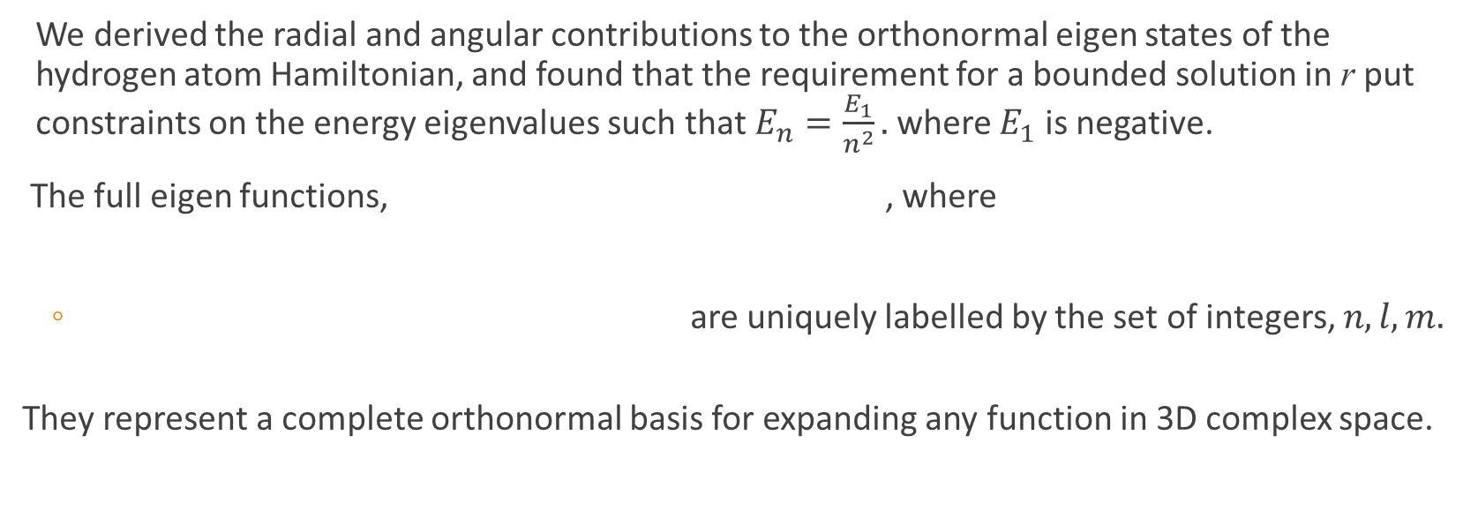
Review of key points from last lecture
We derived the radial and angular contributions to the orthonormal eigen states of the hydrogen atom Hamiltonian, and found that the requirement for a bounded solution in r put constraints on the energy eigenvalues such that $E_{n}=\frac{E_{1}}{n^{2}}.$where $E_{1}$ is negative.
The full eigen functions, , where
are uniquely labelled by the set of integers, $n,l,m.$
They represent a complete orthonormal basis for expanding any function in 3D complex space.

Slide 3
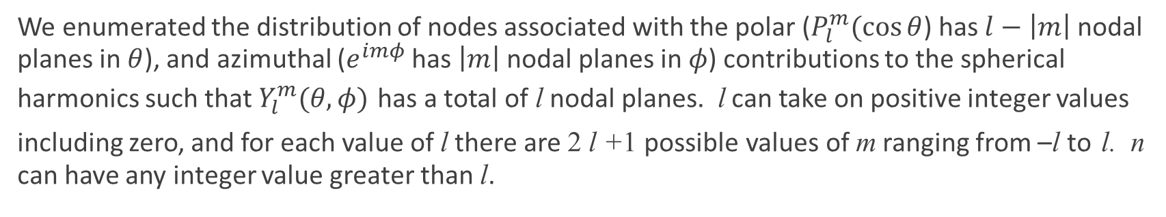
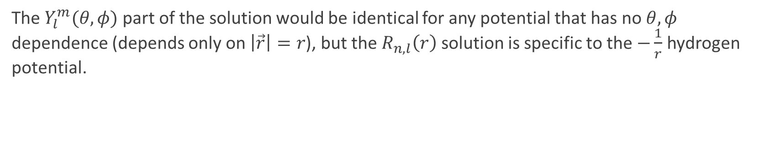
Review of key points from last lecture
We enumerated the distribution of nodes associated with the polar ($P_{l}^{m}(\cos{θ}$) has $l−\left|m\right|$ nodal planes in $θ$), and azimuthal ($e^{imφ}$ has $\left|m\right|$ nodal planes in $φ$) contributions to the spherical harmonics such that $Y_{l}^{m}(θ,φ)$ has a total of l nodal planes. l can take on positive integer values including zero, and for each value of l there are 2 l +1 possible values of m ranging from –l to l. n can have any integer value greater than l.
The $Y_{l}^{m}(θ,φ)$ part of the solution would be identical for any potential that has no $θ,φ$ dependence (depends only on $\left|\vec{r}\right|=r$), but the $R_{n,l}\left(r\right)$ solution is specific to the $−\frac{1}{r}$ hydrogen potential.

Slide 4
Today
Finish off the zoology of full eigen function quantum numbers for the hydrogen atom Hamiltonian
Start dealing with angular momentum operators.

Slide 5

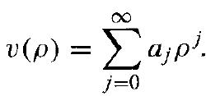
The full eigen functions: spherical potential
Keep track of the nodes!
Recall that the spherical harmonics have a total of $l$ nodes in the angular degrees of freedom.
POLL #1: Based on what we learned in the first half of the course, how many nodes do you think the radial function $R_{n,l}\left(r\right)$ has in the radial degree of freedom?
a) $n$ b) $n−l$ c) $n+l$ d) $n−l+1$ e) $n+l−1$ f) $n−l−1$
Notes:
Based on first half of course, each distinct energy eigen state has a distinct number of nodes (n-1). Thus since Ylm has l nodes, expect Rnl to have n-1-l nodes.

Slide 6
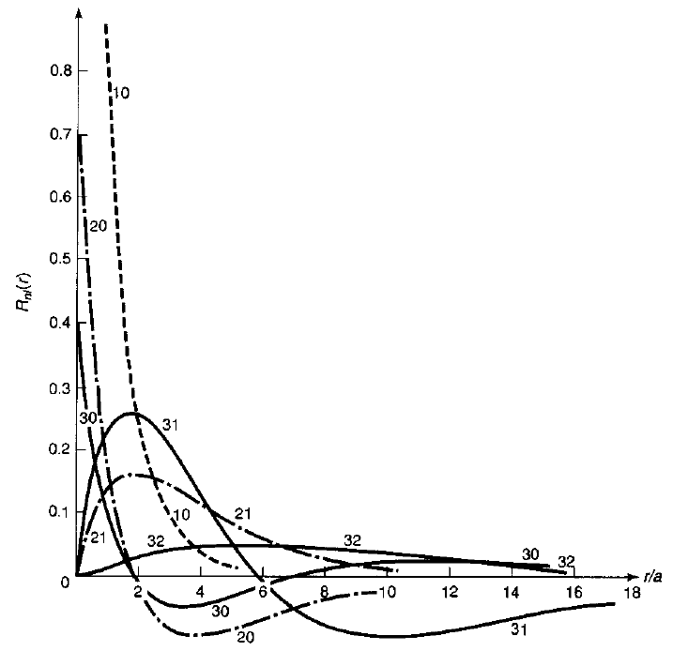

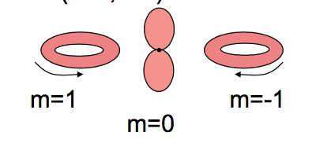
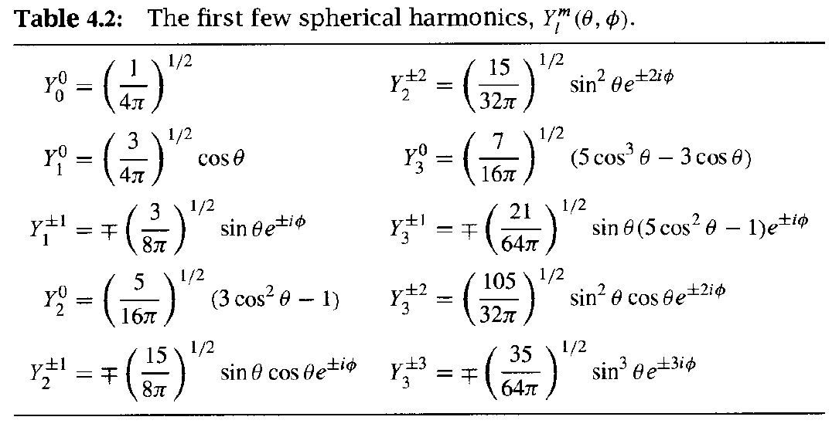
l=1

Slide 7
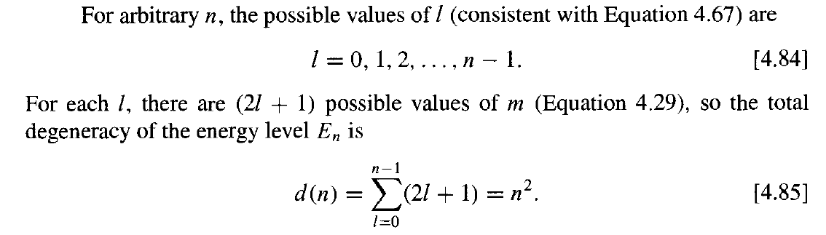
The full eigen functions: spherical potential
Degeneracy of an energy eigen state associated with a given n value?
Only the n quantum number determines the energy of the n² in number states with consistent values of integer l, 0 ≤ l < n, and for each l , m=-l, -l+1,…0,….l (2l+1 in number).

Slide 8
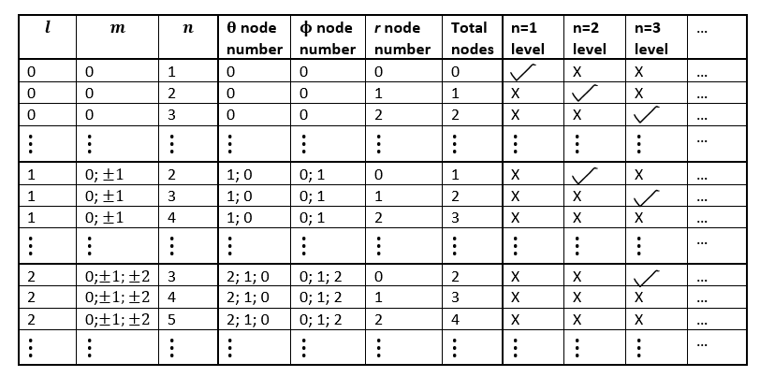
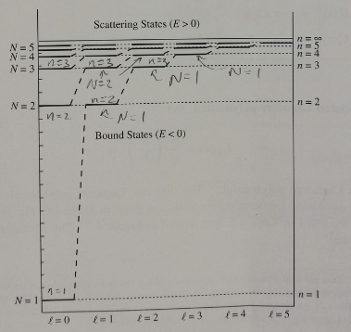
Useful Table
Only the n quantum number determines the energy of the n² in number states with consistent values of integer l, 0 ≤ l < n, and for each l , m=-l, -l+1,…0,….l (2l+1 in number).
Fig 4.6 in 3rd Edition
Notes:
Show graphs from text now, before proceeding. Full psi n,l,m equation figure, Graphs of R vs r, and 2D images, plus, separately, the 3D images of full Wfunctions.

Slide 9
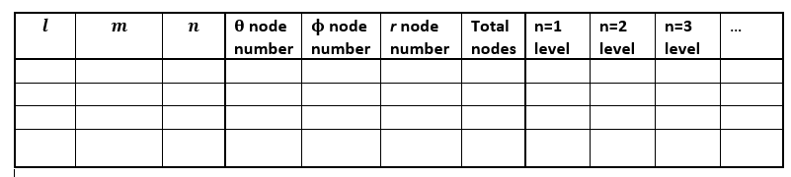
Fill in the blanks
Y/N?

Slide 10
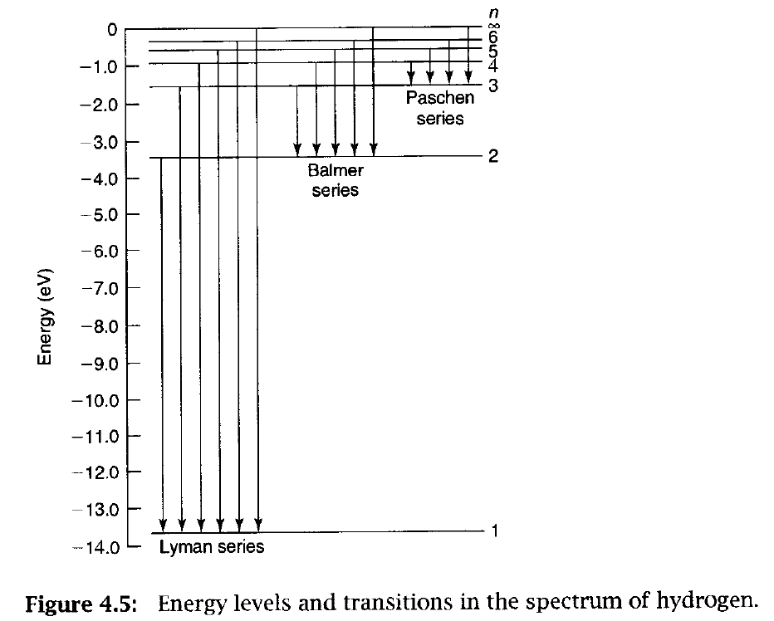
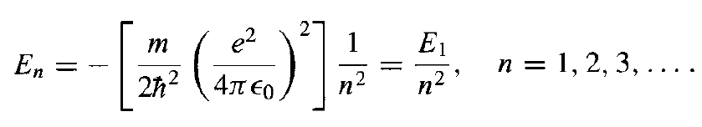
Light emission spectrum
If you could see visible light being emitted from a florescent tube filled only with hydrogen, what can you say about the stationary states that are likely somehow involved in the corresponding light emission process within the hydrogen atoms?

Slide 11
Angular Momentum Operators
At this point in the course, if I asked “what type of wavefunction represents a particle with linear momentum?”, what would you answer?
In classical mechanics, what is the angular momentum equivalent to the linear momentum expression for a particle $p=mdx/dt$?
Combining these answers, which parts of our hydrogen atom eigen functions seem to be directly related to angular momentum?
Which component of angular momentum?

Slide 12
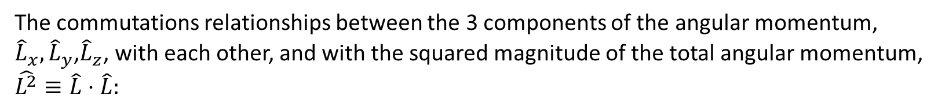
Angular Momentum Operators
The angular momentum operator in the position basis, using cartesian coordinates:
The commutations relationships between the 3 components of the angular momentum, ${\hat{L}}_{x},{\hat{L}}_{y}$,${\hat{L}}_{z}$, with each other, and with the squared magnitude of the total angular momentum, $\hat{L^{2}}≡\hat{L}⋅\hat{L}:$

Slide 13
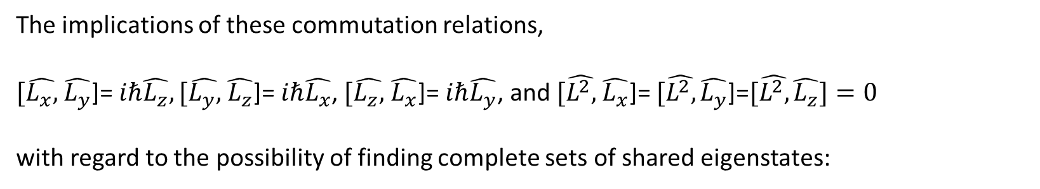

Angular Momentum Operators
The implications of these commutation relations,
$[\hat{L_{x},}$ $\hat{L_{y}}$]= $iℏ\hat{L_{z}}, [\hat{L_{y},}$ $\hat{L_{z}}$]= $iℏ\hat{L_{x}}$, $[\hat{L_{z},}$ $\hat{L_{x}}$]= $iℏ\hat{L_{y}}$, and $[\hat{L^{2},}$ $\hat{L_{x}}$]= $[\hat{L^{2},}\hat{L_{y}}$]=$[\hat{L^{2},}\hat{L_{z}}]=0$
with regard to the possibility of finding complete sets of shared eigenstates:
Lets say you find a common set of eigen states for $\hat{L^{2},}$ and $\hat{L_{z}}$. This is possible because they commute. But since neither $\hat{L_{x}}$ or $\hat{L_{y}}$commute with $\hat{L_{z}}$, they cannot share the same set of shared eigen functions.

Slide 14
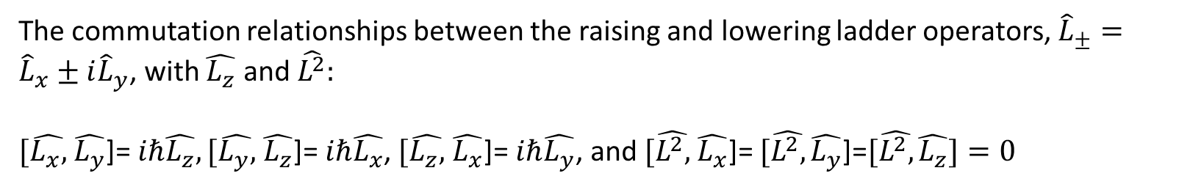
Angular Momentum Operators
The commutation relationships between the raising and lowering ladder operators, ${\hat{L}}_{±}={\hat{L}}_{x}±i{\hat{L}}_{y}$, with $\hat{L_{z}}$ and $\hat{L^{2}}:$
$[\hat{L_{x},}$ $\hat{L_{y}}$]= $iℏ\hat{L_{z}}, [\hat{L_{y},}$ $\hat{L_{z}}$]= $iℏ\hat{L_{x}}$, $[\hat{L_{z},}$ $\hat{L_{x}}$]= $iℏ\hat{L_{y}}$, and $[\hat{L^{2},}$ $\hat{L_{x}}$]= $[\hat{L^{2},}\hat{L_{y}}$]=$[\hat{L^{2},}\hat{L_{z}}]=0$
Notes:
Get them to do it “by inspection”, at least qualitatively for L+/- (must involve sum of Lx and Ly), then go to .jnt notes

Slide 15

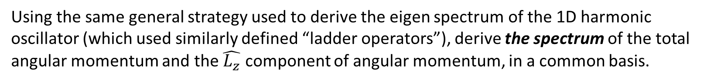
Eigen Spectrum of $\hat{L^{2}}$ and $\hat{L_{z}}$
Using the same general strategy used to derive the eigen spectrum of the 1D harmonic oscillator (which used similarly defined “ladder operators”), derive the spectrum of the total angular momentum and the $\hat{L_{z}}$ component of angular momentum, in a common basis.
Notes:
Start by making sure they understand exactly what the question is asking: the spectrum, not the eigen states…point is that you don’t have to solve the entire problem in order to figure out a lot of information from just using the commutation relations [a general observation about how to “do quantum mechanics”]

